Slide 1
Metaphors
User Mental Model
Direct Manipulation
Feedback & Communication
Consistency
Clarity
User Control
Forgiveness
KIS
Aesthetics & Usability
Don't make me think

Slide 2

UX Intro
Information Architecture
Interaction Design Principles and Usability
Fundamentals of Graphic Design
UI/UX Design and Data Visualization
UI Design for Mobile
Notes:
Важното е де се запознаем с процеса и принципите , а не да заучим някоя техника.
И така нека започнем с дефиниране на цлета си. “Каква в крайна сметка е целта?” ( какъв е смисълът? )

Slide 3
</Front-end> vs {Back-end}

Slide 4
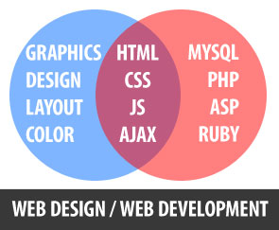
</Front-end> vs {Back-end}

Slide 5

</Front-end> vs {Back-end}

Slide 6
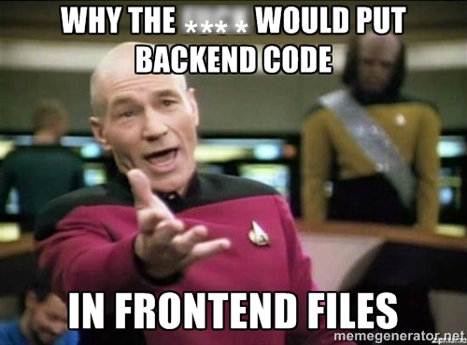

Slide 7
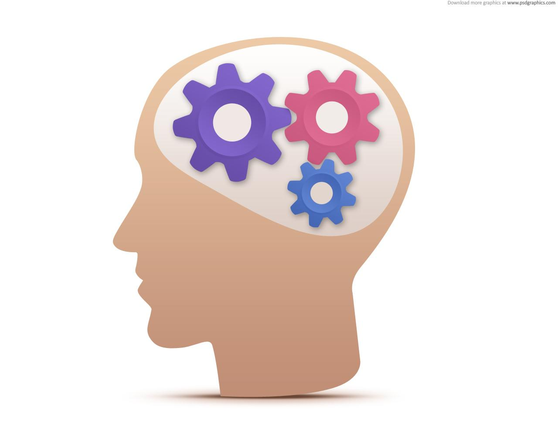
What’s the ?
Intro
Notes:
Каква е нашата цел?

Slide 8
(better)
User Experience
:-)
Intro
Notes:
НАЙ - ВАЖНОТО е като цел за нас като UI/UX деизанери е да подобрим потребителското преживяване!!!

Slide 9
Better UX
=
The benefits are
Easy to use
User friendly
High performance
Better usability
High efficiency
User satisfaction
=
Intro
Notes:
НАЙ - ВАЖНОТО е като цел за нас като UI/UX деизанери е да подобрим потребителското преживяване!!!

Slide 10
Better UX
=
Benefits are
Easy to use
User friendly
High performance
Better usability
High efficiency
User satisfaction
=
Jaxon Daniels says:
I Want it !
Intro
Notes:
НАЙ - ВАЖНОТО е като цел за нас като UI/UX деизанери е да подобрим потребителското преживяване!!!

Slide 11
(better)
User Experience
Intro

Slide 12
UI = UX ?
What’s the difference...
Intro

Slide 13
UI = UX ?
What the UX is...
Intro

Slide 14
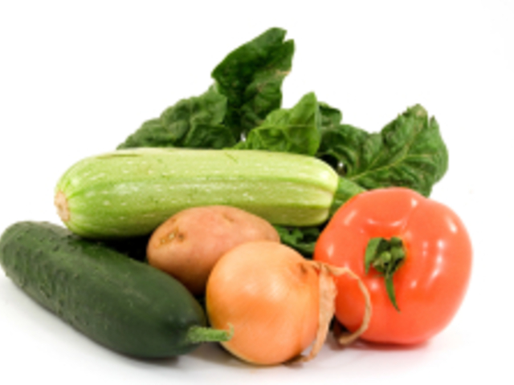
Content
What users are looking for
Intro

Slide 15
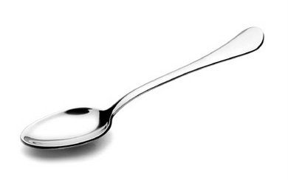
User Interface
Tool to provide the content
Intro

Slide 16

User Experience
All in One
Intro

Slide 17
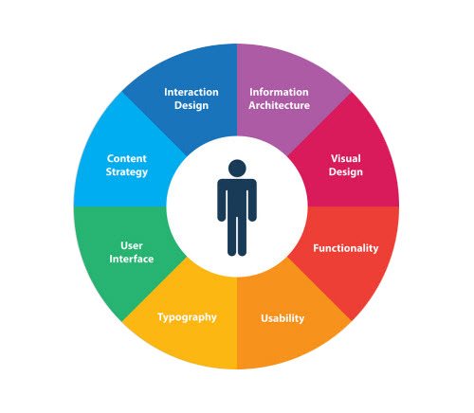
User Experience
Jaxon Daniels
Intro

Slide 18
UI = UX ?
What is the difference...
Intro

Slide 19
UI = UX ?
What the UI is...
Intro

Slide 20
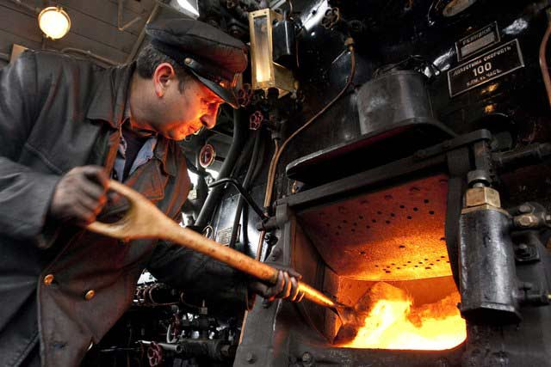
UI HISTORY ?
User Interface ?
“The way that you accomplish tasks with a product – what you do and how it responds – that’s the interface”
Jef Raskin
Intro
Notes:
Начинът, по който вие изпълнение една задачa с продукта - това, което правиш и как той реагира - това е интерфейса :)

Slide 21
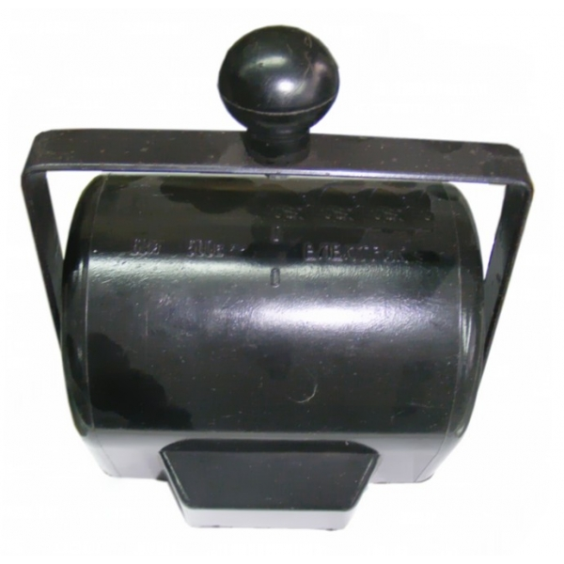
User Interface ?
Intro

Slide 22

User Interface ?
Intro

Slide 23
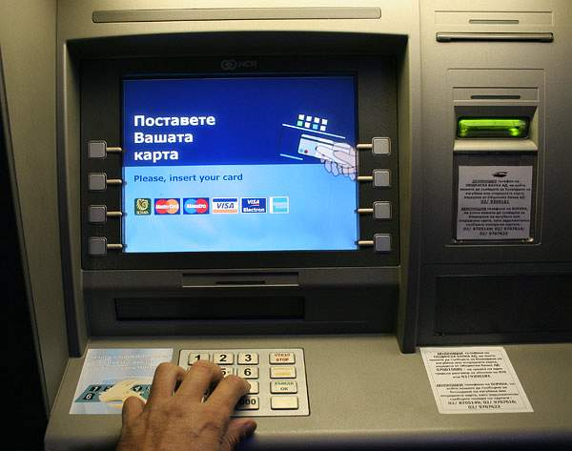
User Interface ?
Intro

Slide 24
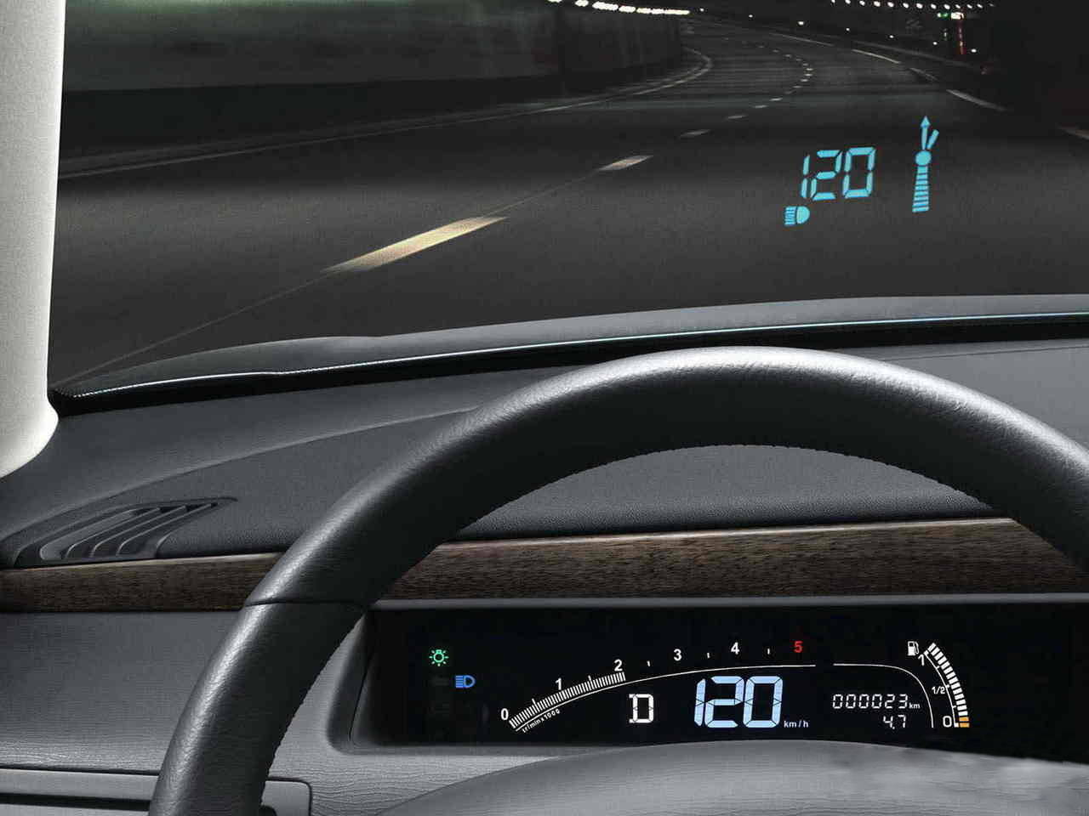
User Interface ?
Intro

Slide 25
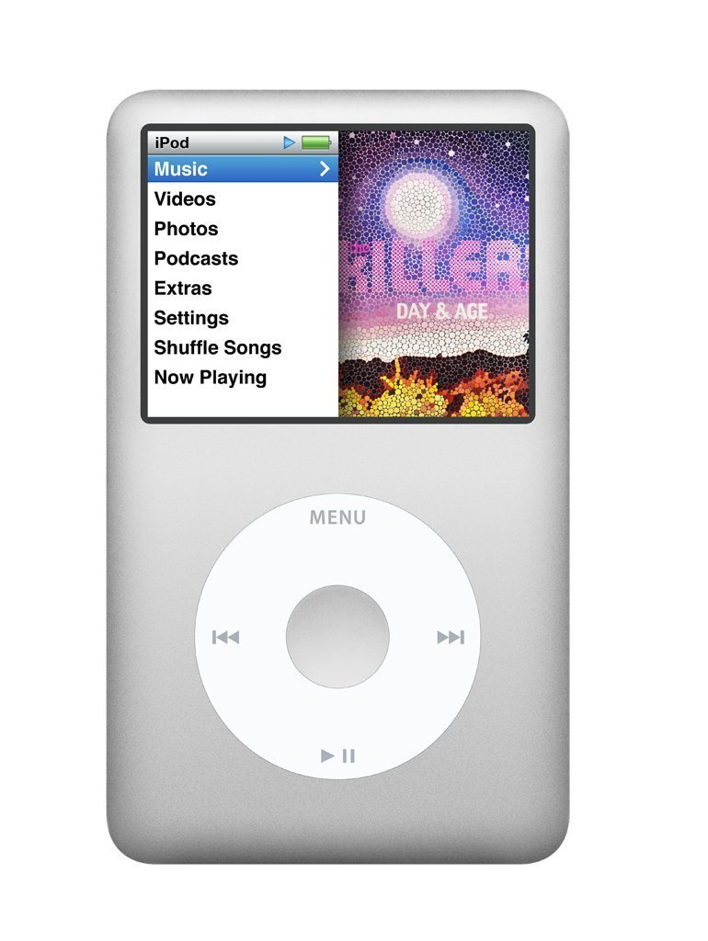
User Interface ?
Intro

Slide 26

HCI
Human - Computer Interaction
Intro

Slide 27
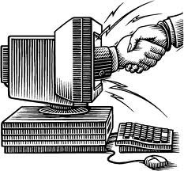
Nice to meet you!
Intro

Slide 28
< User Interface / >
Command line UI
Graphical UI
Natural UI
CLI
GUI
NUI
Codified
Metaphor
Direct
Strict
Explanatory
Intuitive
Intro

Slide 29
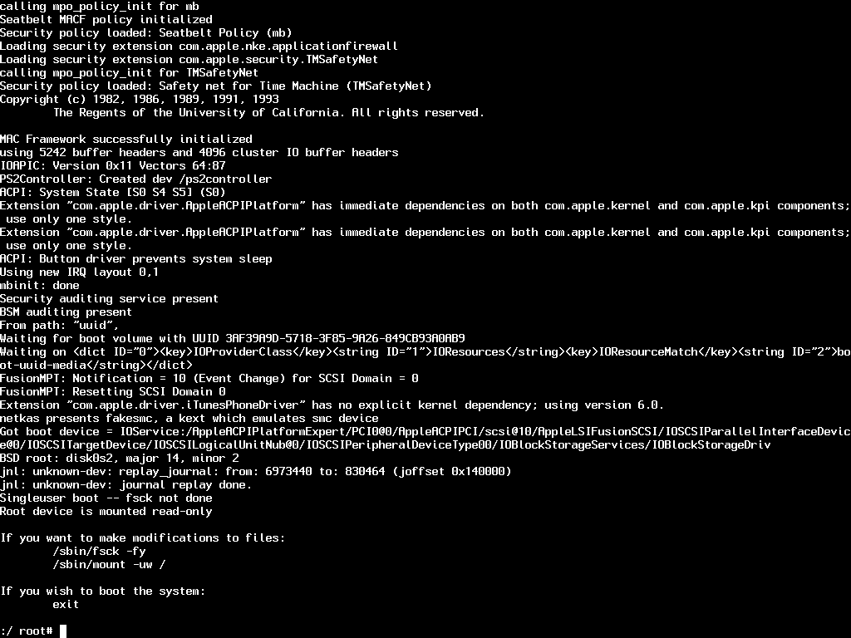
CLI

Slide 30
CLI
Demo
CLI
Notes:
play rock
fm pause

Slide 31
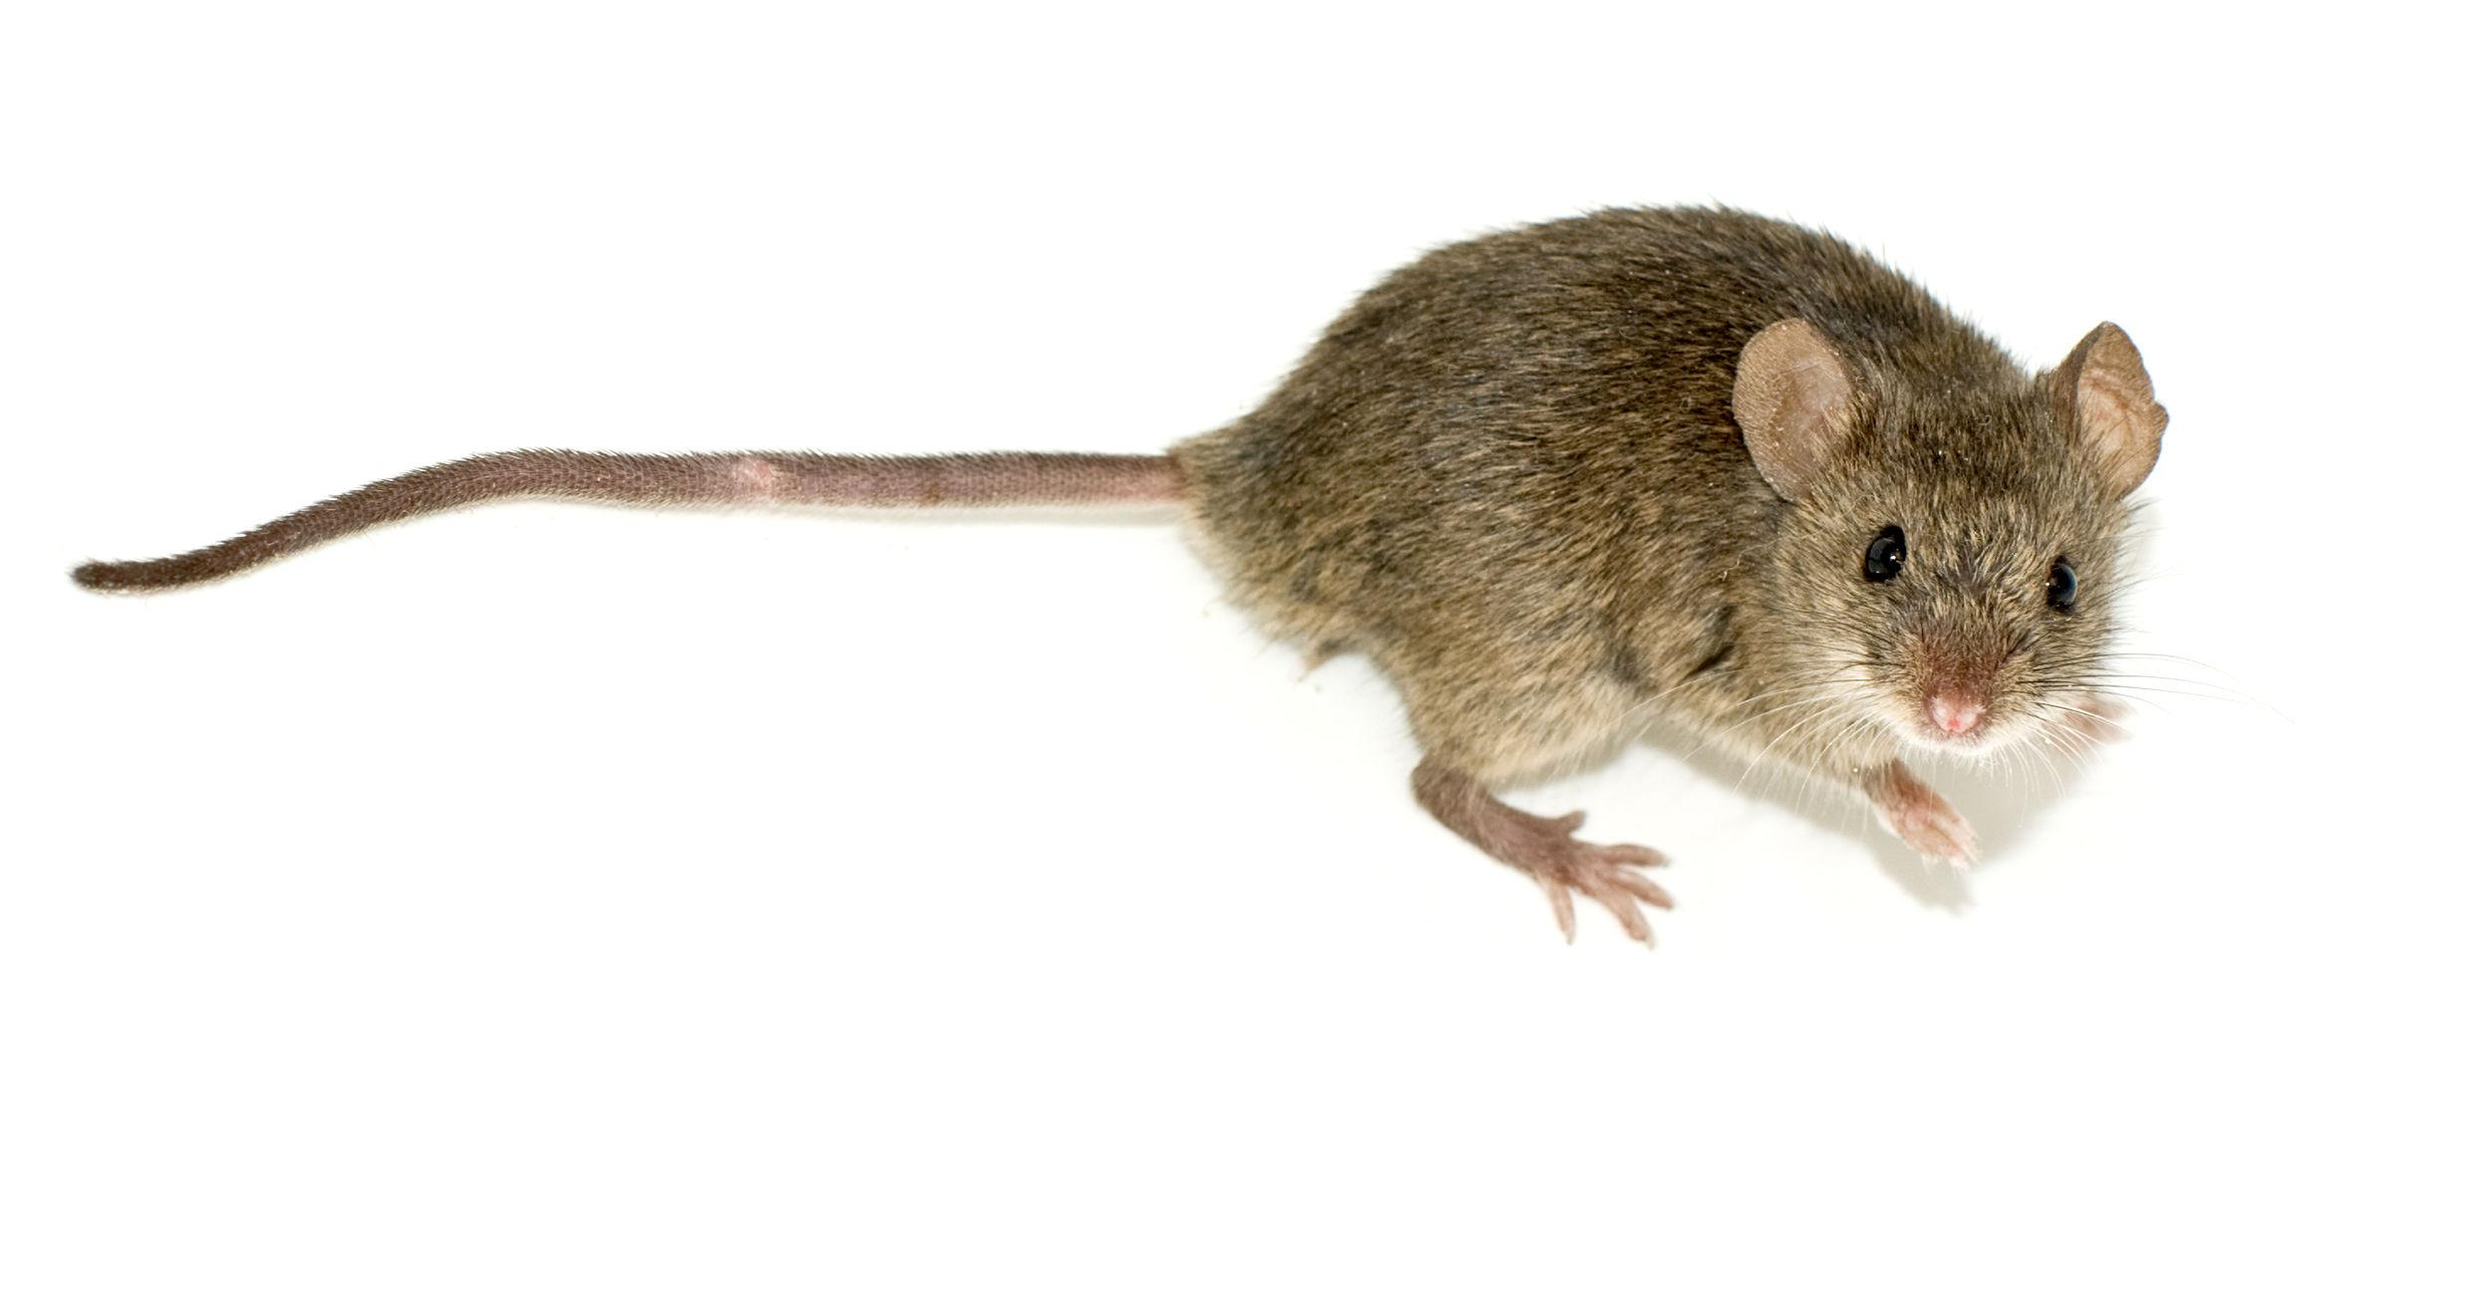
1984
Hello.
GUI

Slide 32
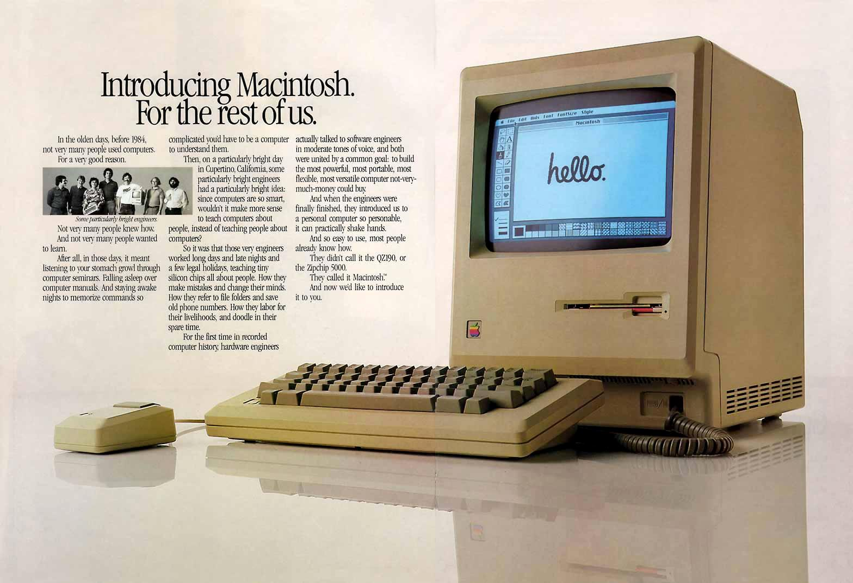
GUI

Slide 33
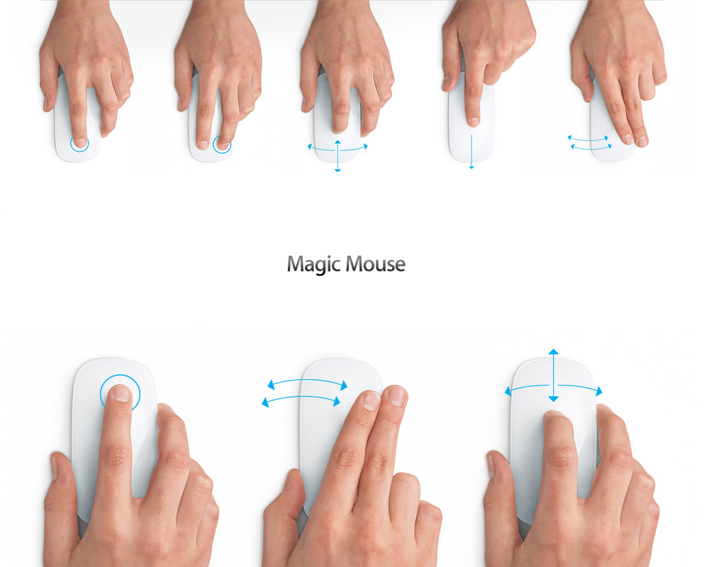
Click once? > tap, swipe, pinch...
GUI

Slide 34
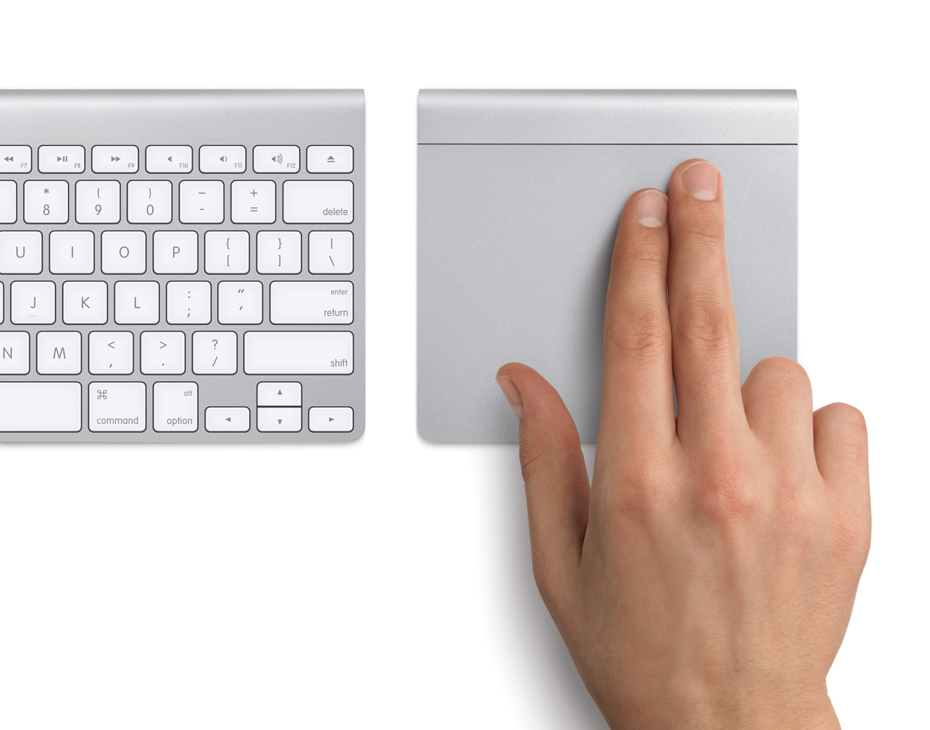
GUI

Slide 35
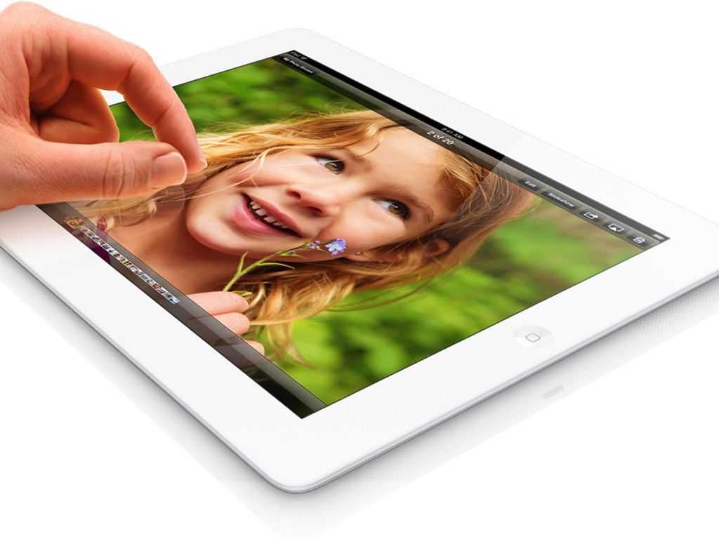
Direct, Intuitive
GUI

Slide 36
< User Interface >
CLI
GUI
NUI
timeline
GUI

Slide 37
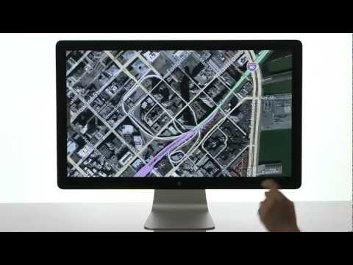
Natural UI

Slide 38
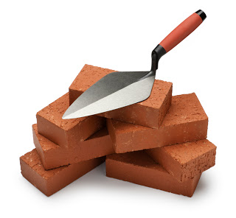
UI UX
DESIGN
10+ Fundamental Principles of
Notes:
UI UX дизйана - като в строителството ,тухла по тухла - надграждаме, за да получим крайния резултат.
Тук ще разгледаме 10-на от принципите ( по- склоро са като насоки, а не техники ) за постигането на целата ни. Биха могли да се опишат в книга 101 основни принципа на…… Но ще бъде объркващо.
В рамките на целия семинар сме обхванали почти всички аспекти от целия процес…

Slide 39
Metaphors
User Mental Model
Direct Manipulation
Feedback & Communication
Consistency
Clarity
User Control
Forgiveness
KIS
Aesthetics & Usability
Don't make me think

Slide 40
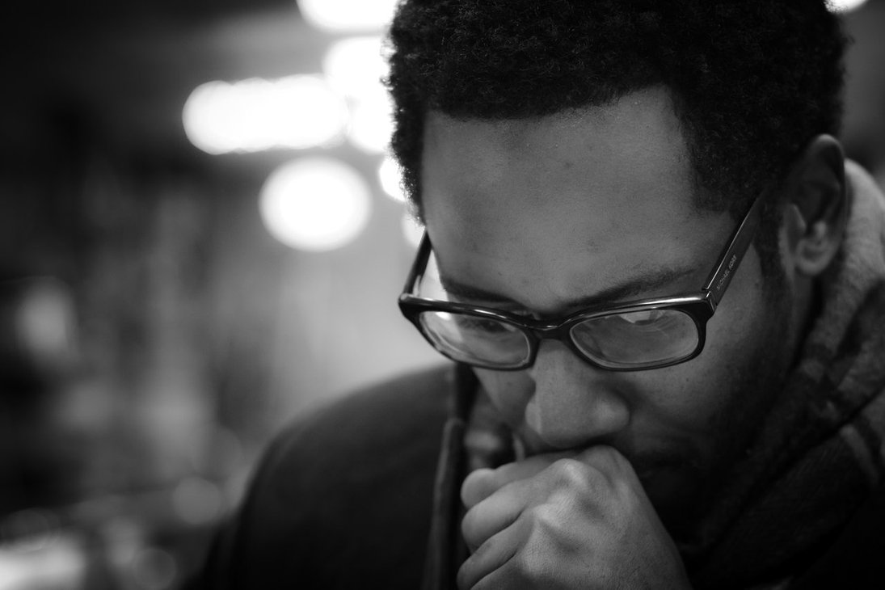
Don’t Make Me Think !
http://www.uxbooth.com/articles/10-usability-lessons-from-steve-krug%E2%80%99s-dont-make-me-think/
p01

Slide 41

Make it easy to go home !
p01

Slide 42
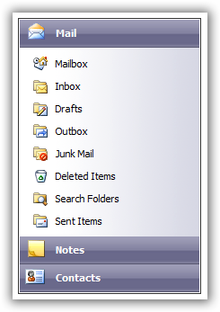
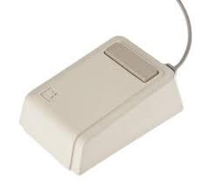
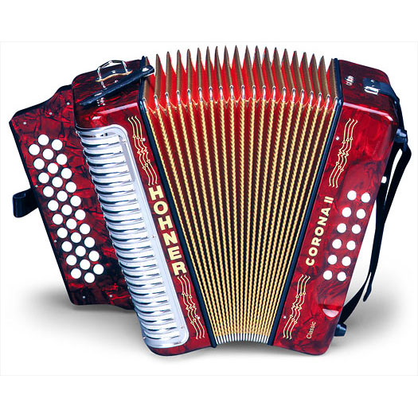

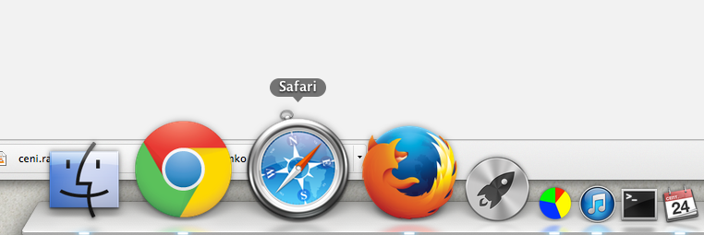
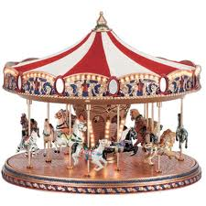
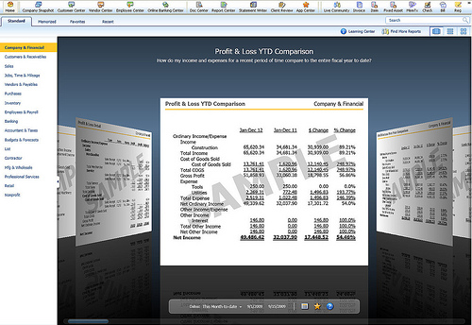
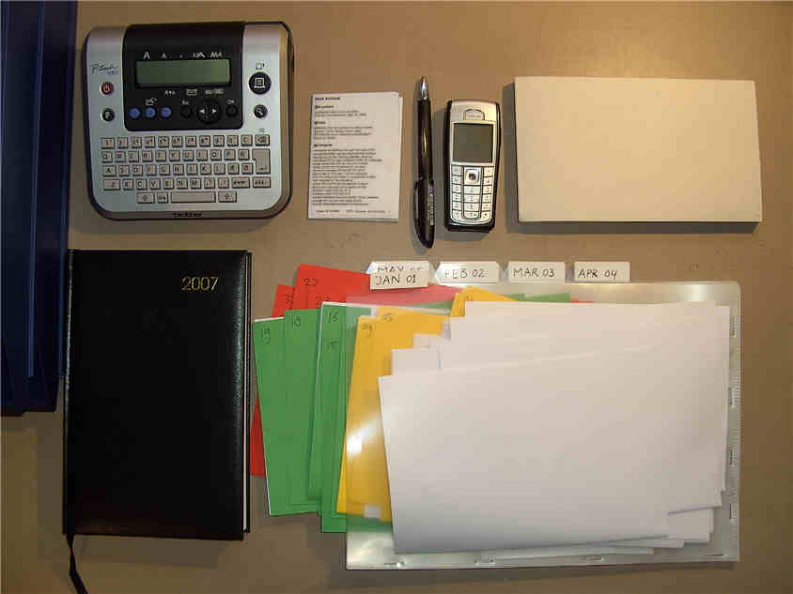
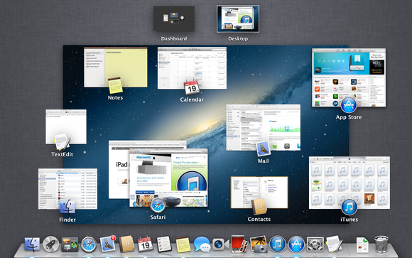
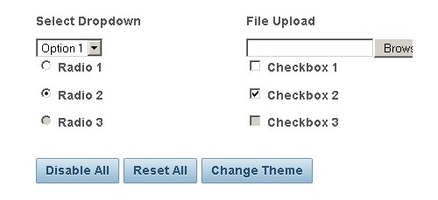
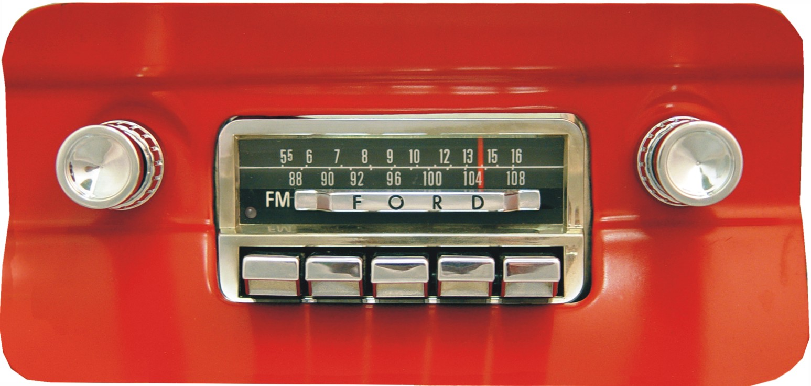
Metaphors
Metaphors
p02
Notes:
Mouse - Xerox PARC (Palo Alto Research Center Incorporated)

Slide 43
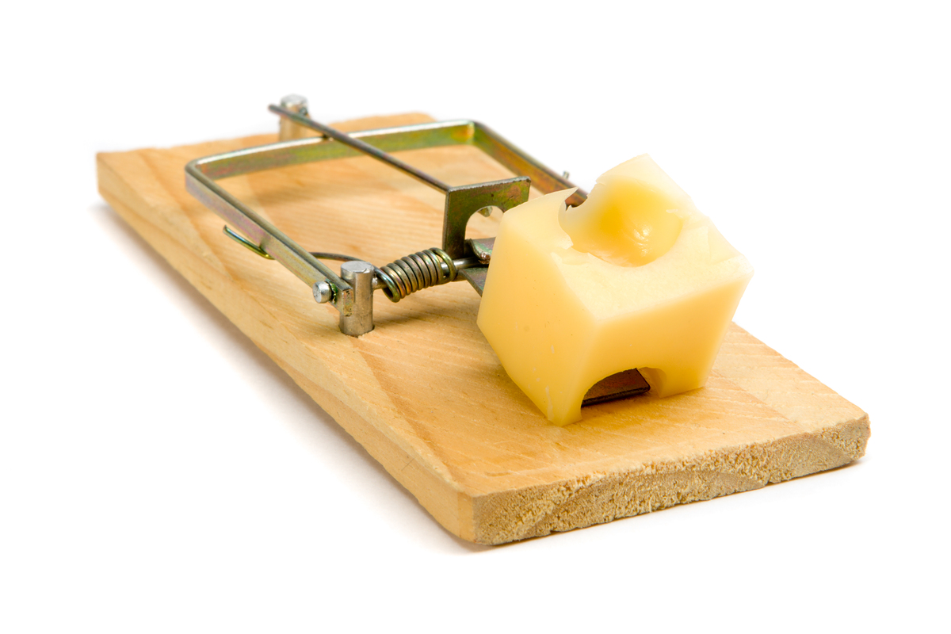
Metaphors CAN:
Put Abstract Concepts in Concrete Terms
Create Familiarity
Trigger Emotions
Draw the Attention of Users
Motivate Users into Action
p02

Slide 44
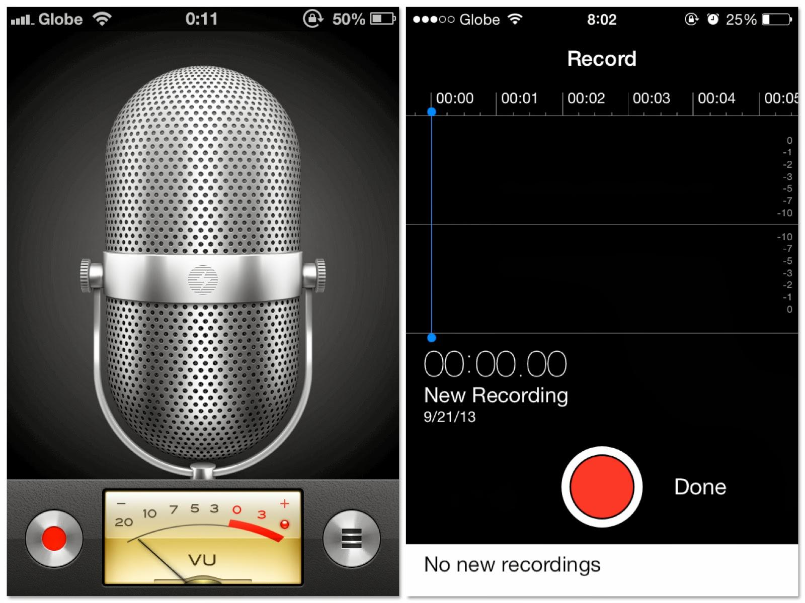
Skeuomorphism vs FLAT
p02

Slide 45
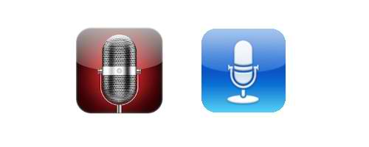
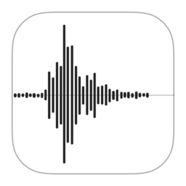
Skeuomorphism vs FLAT
examples
p02

Slide 46
Save...
p02

Slide 47
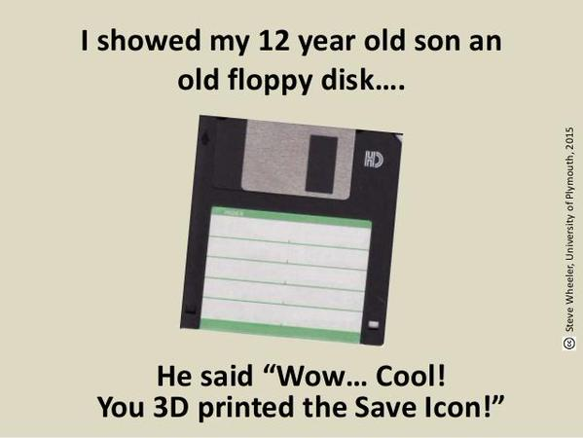
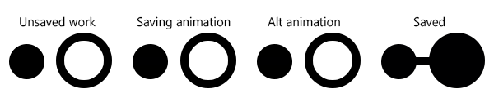
p02

Slide 48
Old school мetaphors or not ?
examples
p02

Slide 49
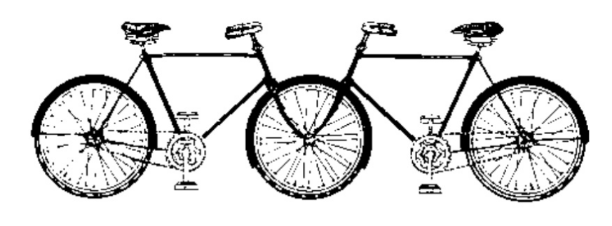
User Mental Model
Mental model is what a user believe is true, not necessarily what is actually true.
p03

Slide 50
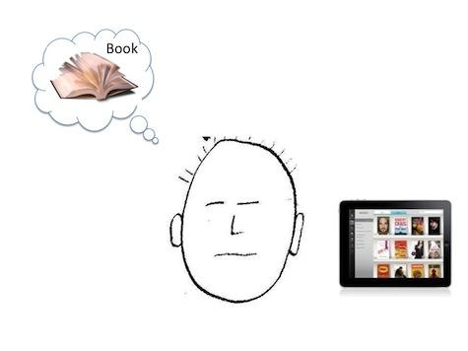
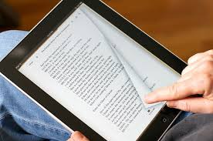
User Mental Model
“Imagine that you’ve never seen an iPad, but I’ve just handed one to you and told you that you can read books on it. Before you turn on the iPad, before you use it, you have a model in your head of what reading a book on the iPad will be like. You have assumptions about what the book will look like on the screen, what things you will be able to do, and how you will do them—things like turning a page, or using a bookmark. You have a “mental model” of reading a book on the iPad, even if you’ve never done it before.”

Slide 51

How do we think?
How the things work?
Provide obvious conceptual models
Make things visible
Make users ‘see’ how things work
p03

Slide 52
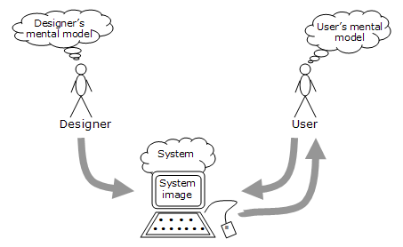
User Mental Model
What users believe they know about a UI strongly impacts how they use it.
p03

Slide 53

User Control
Give users control
p04

Slide 54

User Control
Allow the user, not the computer, to initiate
and control actions
“if you do this that will happen”
Provide the level of user control that is appropriate for your audience.
p04

Slide 55
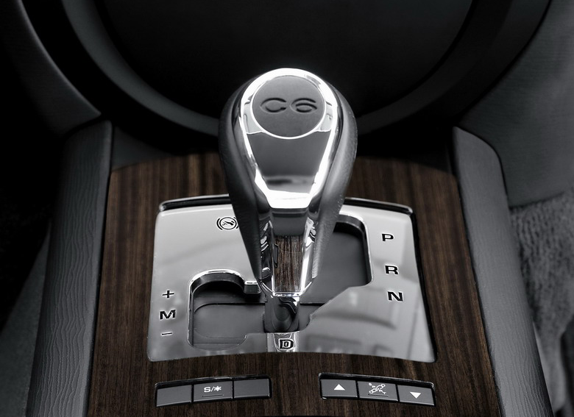
Direct Manipulation
Allows users to feel that they are controlling the objects
p05

Slide 56
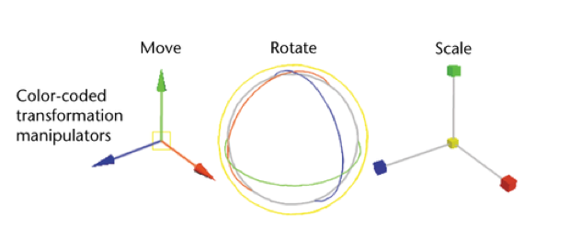
Direct Manipulation
Keep users focus on action
One primary action per screen ( area )
Examples :
Drag and drop ( vs cut & paste )
Resizing directly via handles
p05

Slide 57

Feedback and Communication
p06

Slide 58
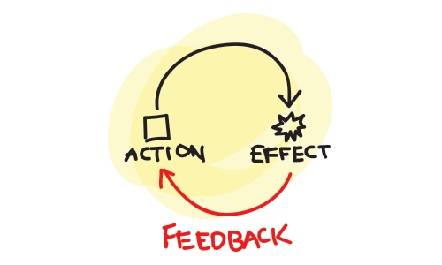
Feedback and Communication
p06

Slide 59
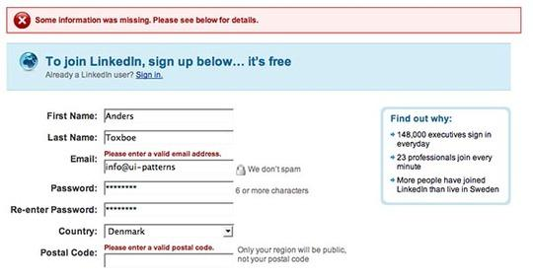
Feedback and Communication
Validation forms
p06

Slide 60
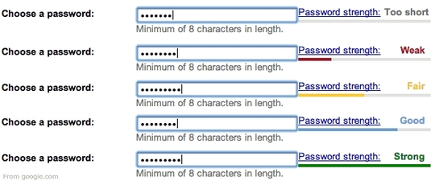
Feedback and Communication
Password Strength Meter
p06

Slide 61

Feedback and Communication
Provide users information about system
What is happened ?
Where the things go?
p06

Slide 62
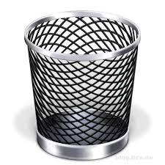
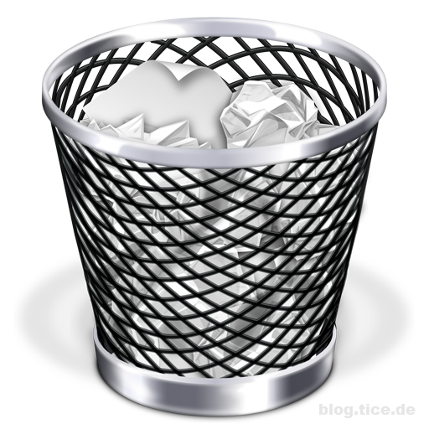
Feedback and Communication
Provide users information about system
p06

Slide 63
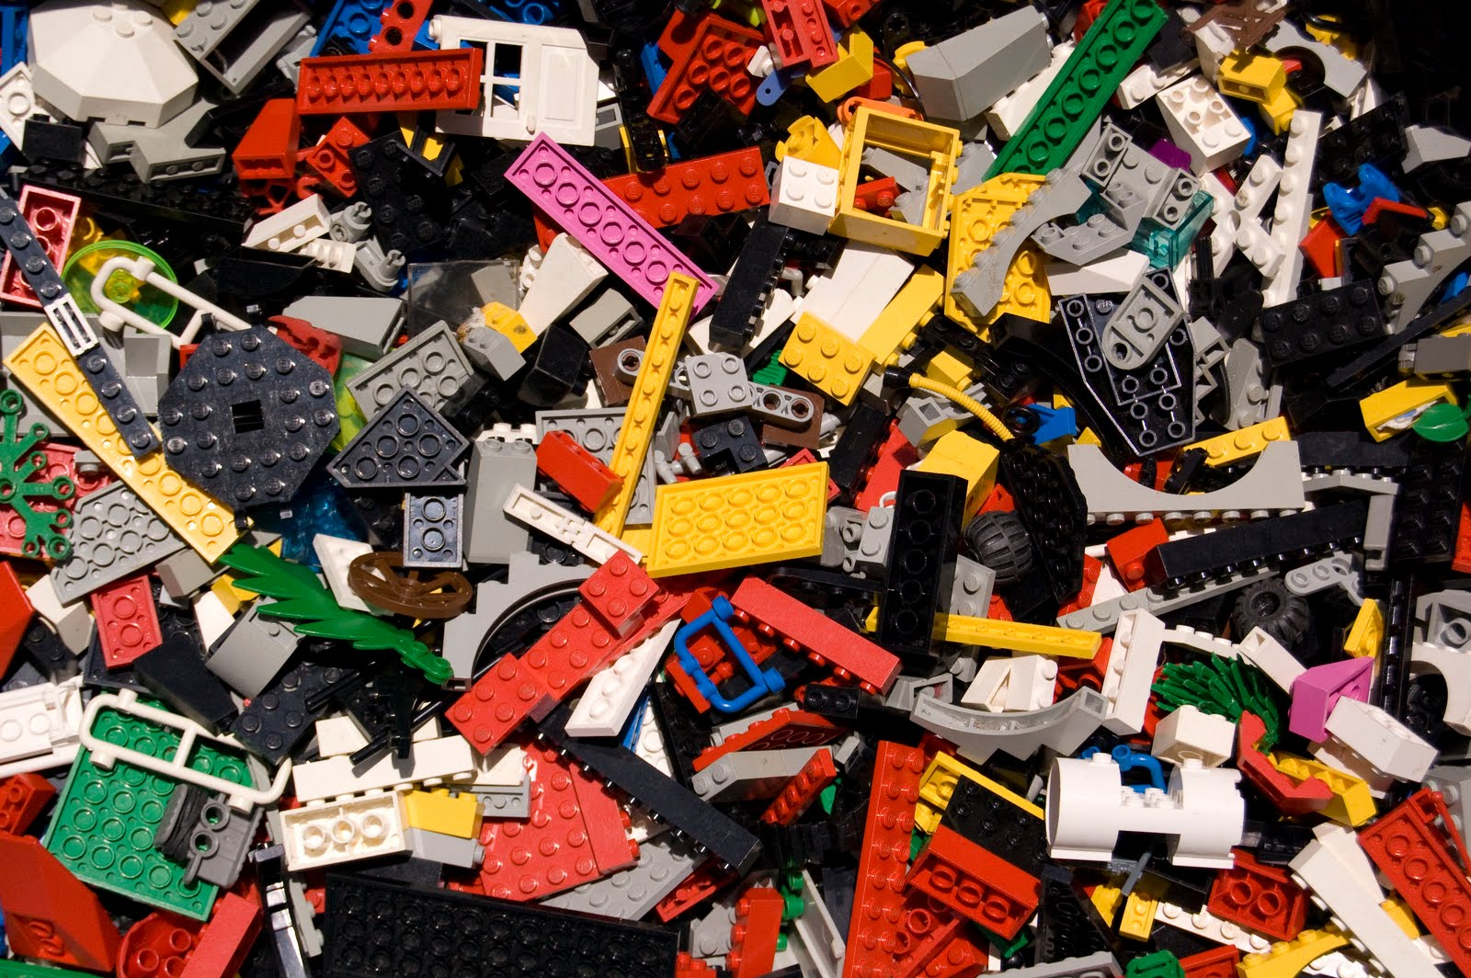
Consistency
p07

Slide 64
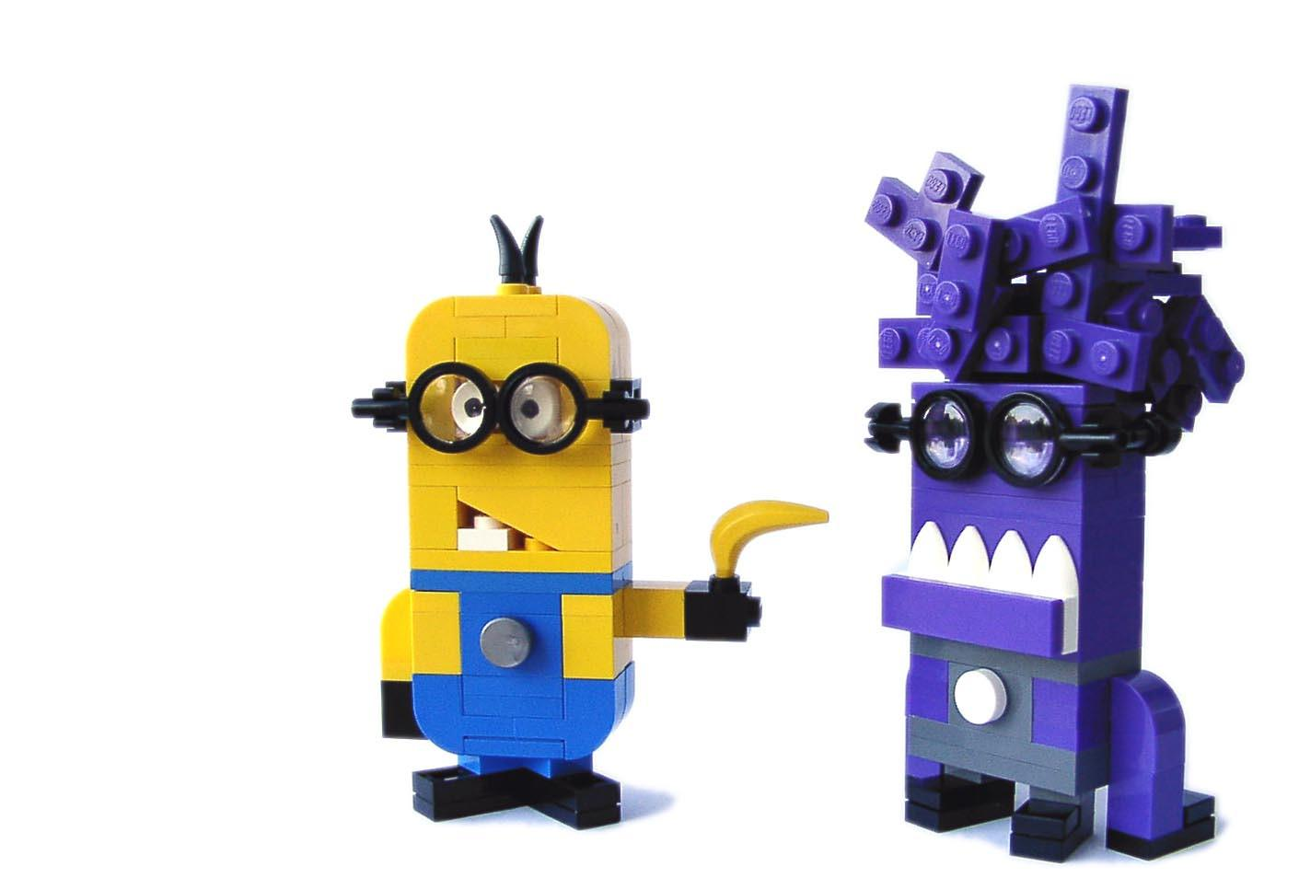
Consistency Tips:
p06

Slide 65
Consistency Tips:
Create own assets of common UI Elements
Reuse UI Elements
Follow the design patterns ( autocomplete etc. )
Typography: size, labels, colors
Fibonacci sequence ( ...8, 13, 21, 34, 55, 89, 144... )
hint :
p06

Slide 66

Consistency Questions
Consistency of your product meets ... ?
System standards ...
Within Itself...
Earlier versions ...
User’s expectations ...
p06

Slide 67

Forgiveness
Support for errors !
p07

Slide 68

Forgiveness
The most forgiving design is one which helps people avoid making mistakes.
p07

Slide 69


Forgiveness
Warning Users
of any potentially serious consequence of a given action.
p07

Slide 70

Aesthetics or Usability?
p08

Slide 71

Aesthetics or Usability?
Both.
p08

Slide 72

Fitt’s Law
The time to acquire a target is a function of the distance to and size of the target.
Paul Fitts in 1954
p08
Notes:
Paul M. Фитц (1912-1965) е психолог в Държавния университет Охайо (по-късно в Университета на Мичиган).
Той разработва модел на човешкото движение,

Slide 73

Clarity
The information content has to be provided
quickly and accurately
What does that do?
“If people can’t figure out how your application works or where to go on your website they’ll get confused and frustrated.”
p09

Slide 74

Clarity
p09

Slide 75

Keep it simple
p10

Slide 76
KIS
Do more with less!
"Everything should be made as simple as possible, but not simpler."
Albert Einstein
p10
Notes:
Нещата трябва да са възможно най-опростени, но не и прости.

Slide 77

“A modern paradox is that it’s simpler to create complex interfaces because it’s so complex to simplify them.”
p10

Slide 78
“A modern paradox is that it’s simpler to create complex interfaces because it’s so complex to simplify them.”
Keep it simple
p10

Slide 79
Good UI is obvious.
p10

Slide 80
Great UI is invisible!
p10

Slide 81

The real thing...

Slide 82

UI and UX design process

Slide 83

Brainstorming

Slide 84

Sketching

Slide 85

A/B Testing

Slide 86

Tiny tweaks and modifications

Slide 87

Wireframes

Slide 88

Design for mobile

Slide 89


Slide 90

Testing on the device

Slide 91

Designing Win 8 App

Slide 92

Take advantage of the space

Slide 93

Specific actions for the platform

Slide 94

best practices
Notes:
Всички примери са от релани apps от wp8 store и app store - всички са за финансови софтуери!!!

Slide 95

Crowded UI

Slide 96

Too heavy background

Slide 97

Inactive content

Slide 98

Inconsistent UI

Slide 99

Wrong focus

Slide 100

Too much data

Slide 101

Confusing information

Slide 102

Inconsistency

Slide 103
11

Slide 104

Pay аttention to detail!

Slide 105
?

Slide 106


Thank You!
Tyanko Yordanov
UX designer , senior
Platform & Cloud Services Interaction Design Team
tyanko.yordanov@telerik.com
Telerik Platform
Thanks to:
Vesselin Dochkov
Georgi Atanasov
a.k.a - xLabs Team

Slide 107
http://en.wikipedia.org/wiki/Jef_Raskin
http://www.1stwebdesigner.com/design/user-interface-metaphor-links/
http://www.sensible.com/
http://uxdesign.smashingmagazine.com/
http://blog.teamtreehouse.com/10-user-interface-design-fundamentals
http://www.allaboutux.org/
https://developer.apple.com/library/mac/documentation/UserExperience/Conceptual/AppleHIGuidelines/HIPrinciples/HIPrinciples.html#//apple_ref/doc/uid/TP30000353-TP6
http://nilosarraf.com/2011/06/14/metal-models/
http://sixrevisions.com/user-interface/5-reasons-why-metaphors-can-improve-the-user-experience/
http://www.nngroup.com/courses/hci/
Resources

